Slide 1
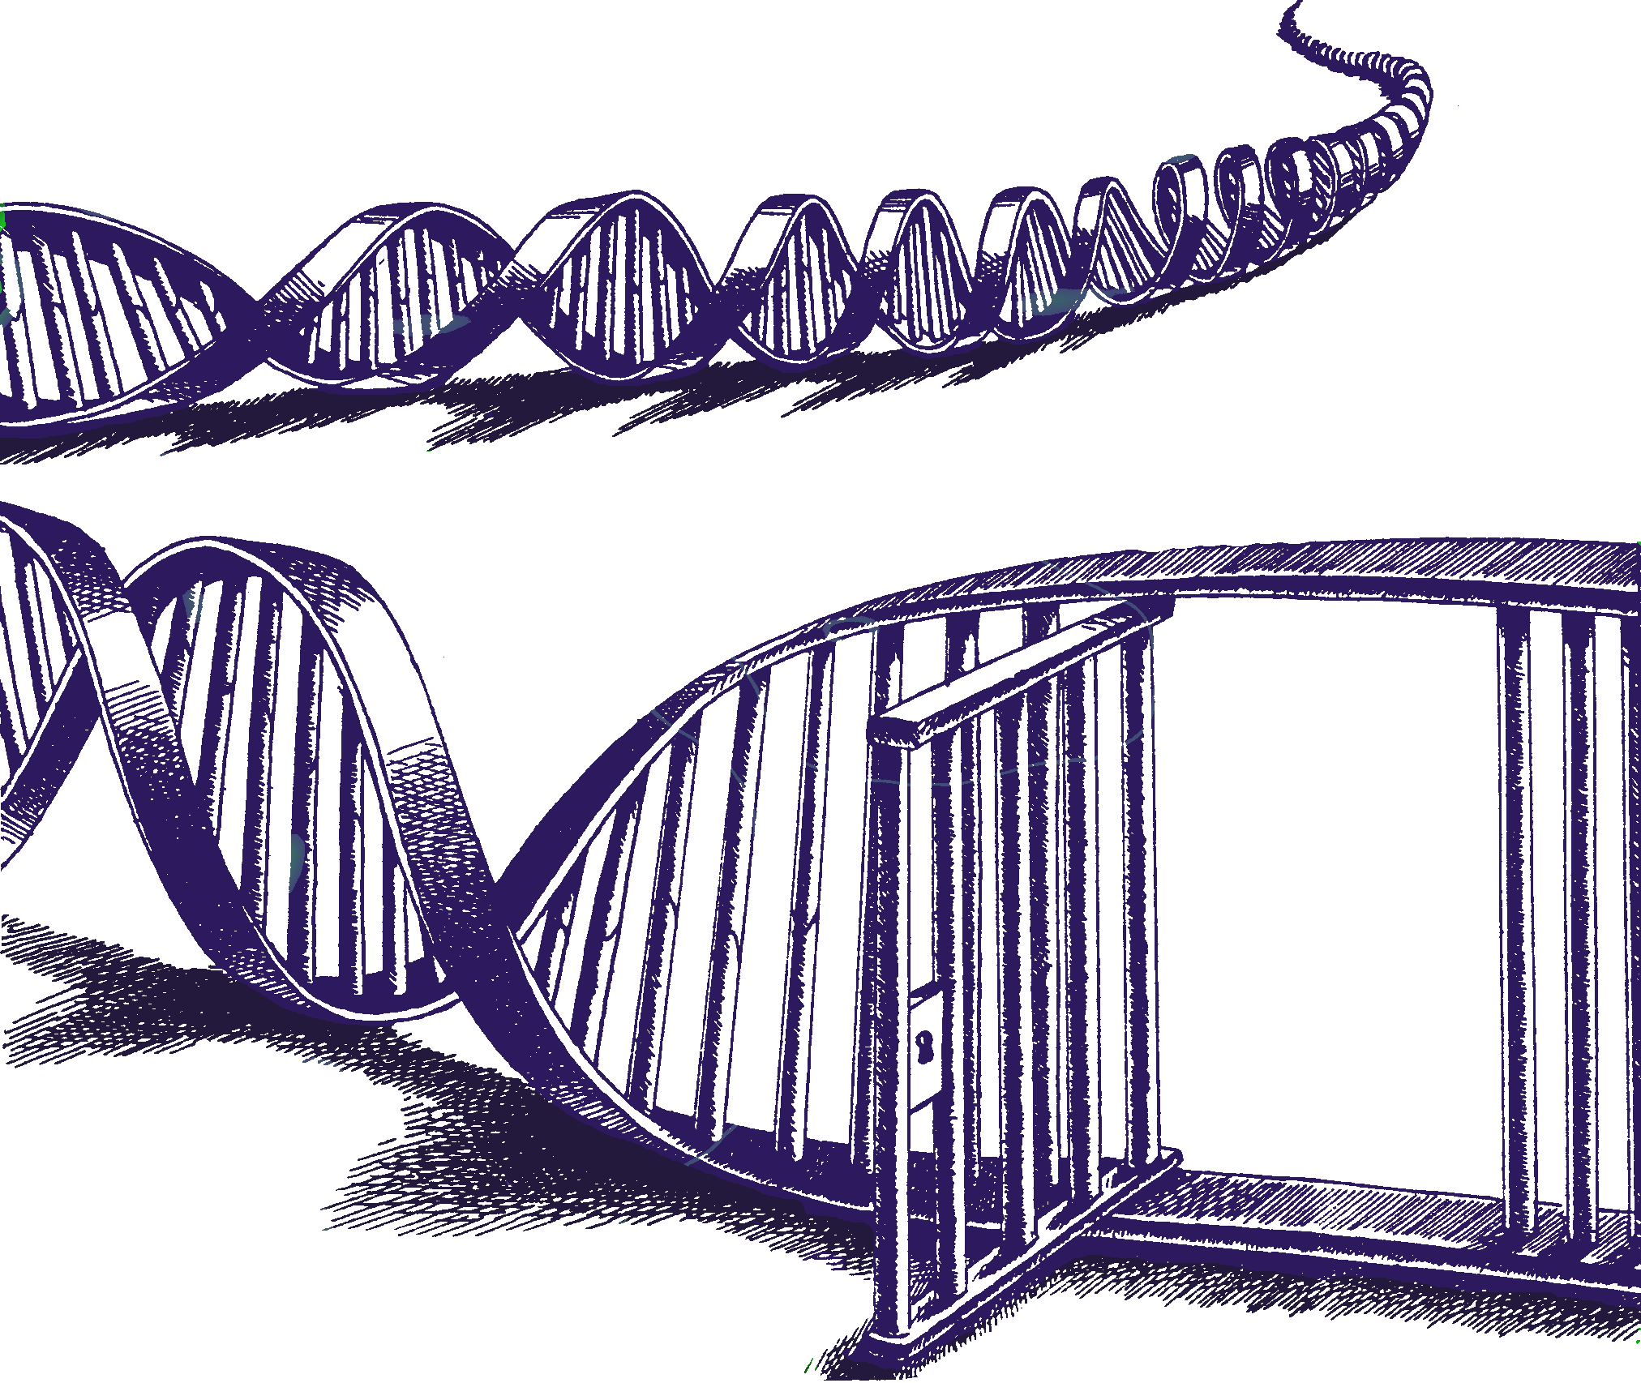
Questioning the unquestioned – Rejecting mixture lore of yore
W:\meetings\aafs\16\
Debunking accepted mixture concepts.pptx
24 Feb 2016
Lessons from Mixture Solution™ program development
Charles Brenner, Ph.D.
Purveyor of forensic mathematics, DNA∙VIEW®,
Senior Research Fellow at UC Berkeley Human Rights Center
http://dna-view.com c@dna-view.com +1 510 798 7139
Notes:
Disclosures – DNA-VIEW is the name of my software and (informally) of my business.
Mixture Solution is a part of it that will get some brief mention in this generally academic talk.
To discuss it later this week though here’s my phone #, I’ll expect to demo at Bode booth 1 & 3pm today; official release of the Windows version is in March.
In accord with the AAFS request, in case I happen to refer to competing programs STRmix/TrueAllele I should let you know that I have no stake.

Slide 2
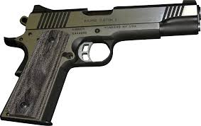

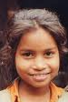
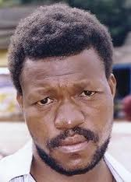

Mixture characteristics
Hats & guns
  Then (rape, murder(fingernail), …)
  Now (gun grip, ski mask, grab touch)
  Multiple suspects, references , unclear # of contributors
  More mixtures
More complicated mixtures
Explore + analyze
Notes:
New age of mixtures >> hypotheses (both which references & how many unknowns) may be not obvious.
New need is to explore as well as analyze.

Slide 3
Ad hoc “theories”
Forensic statistics mostly ad hoc
  Jumble of approximate ideas
Example: Autosomal “theory” approximations fail horribly as Y-haplotype methods
Are traditional mixture ideas similarly bad?
Notes:
Contrarian theme
Contrarian theses are always seductive. Let me know if I go overboard; I’ll try not to.

Slide 4
Conclusions
Concept
Verdict
Likelihood ratio
Exclusion, Excluded
Allele present
Contribute, Contributor
Number of contributors
Markov-Chain Monte Carlo
Stochastic threshold
1-person “mixture”
Speed
Likelihood
Good
Meaningless & shifty
Undeterminable
Undefinable
Questionable, arbitrary
Unnecessary
Thoughtless vestige
Clarifying concept
Paradigm shift
Good
Notes:
L – timeless
Exclusion – confusion (re “Property of evidence” vs “decision by analyst” –
& what decision: “Free to go, come by for dinner”, or some term of art?)
# contributors – Arbitrary but with a minimum. The stuff about “contributors” is my best material.
Stochastic threshold bad idea since forever. 1-person mixture is the ticket.
Speed & MCMC – probably another talk

Slide 5
What’s wrong with the old ways?
Exclusion approach
  Analyst judgement:
    Subjective
    Undefinable terms – “exclude” etc.
  Quantified using CPE by totally different criteria:
    “Included” ≡ all suspect alleles observed above threshold
    “excluded” ≡ not included
    “inconclusive” doesn’t exist
  Very poor model of what analysts do
CPE has little to do with the evidence
Conservative? Only when the analyst is right!
inclusion
inconclusive
exclusion
(p+q+r)²
Notes:
“Exclude” undefined: In the plain English sense that “We can exclude the possibility that J’s DNA is part of this”, we can virtually never exclude him as a scant contributor. We can redefine “exclude” to mean “exclude as a copious contributor” but that’s – literally – shifty, i.e. misleading and dishonest because normally not judicially relevant.
The value of the CPE jumps up and down randomly according to the arbitrarily chosen analytic threshold.

Slide 6
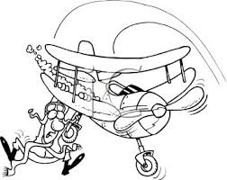
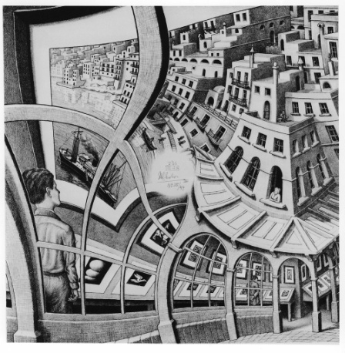
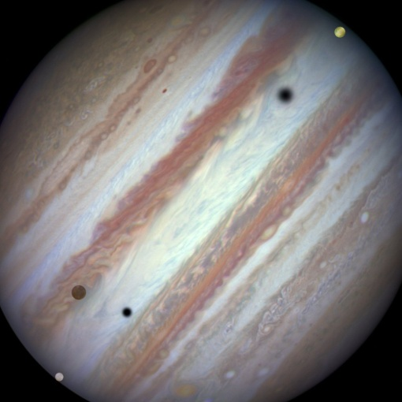
Why go continuous?
Less subjectivity
Dropout
Model more accurately, more information
Notes:
As simple as possible but no simpler. (One of the few Einstein quotes on the Internet that he nearly said:
It can scarcely be denied that the supreme goal of all theory is to make the irreducible basic elements as simple and as few as possible without having to surrender the adequate representation of a single datum of experience.)

Slide 7
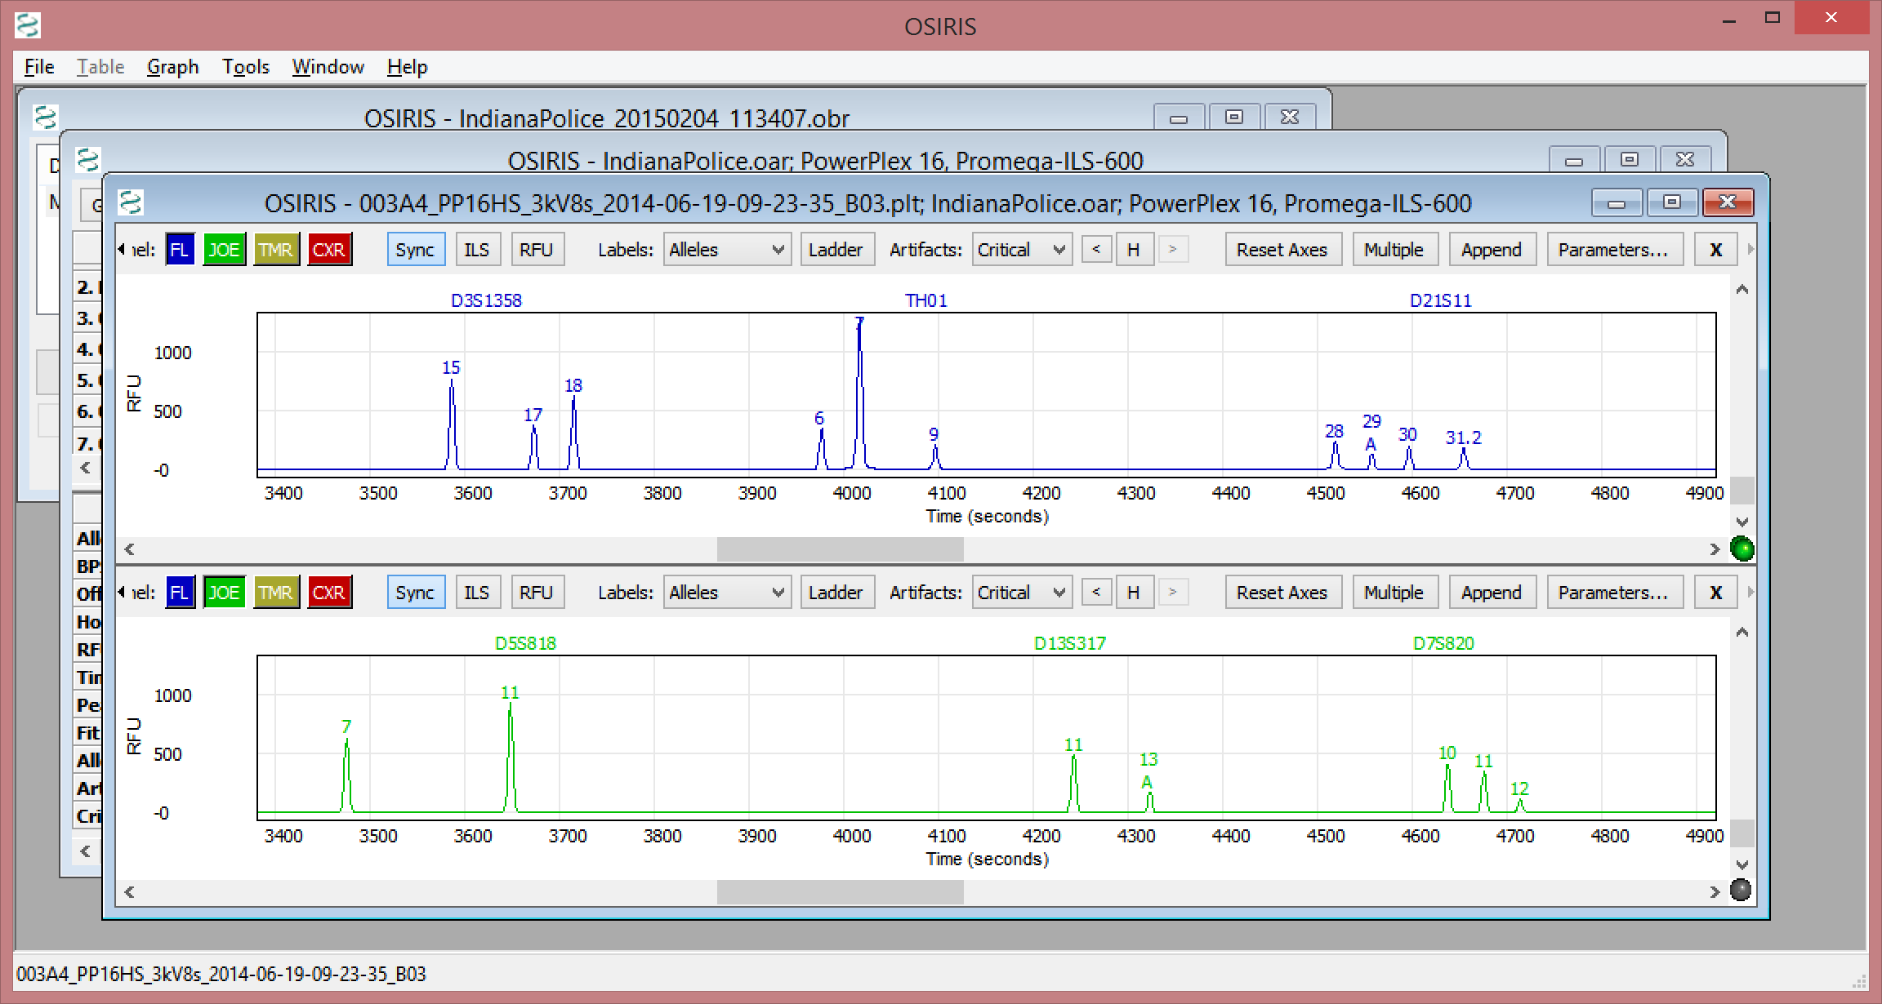
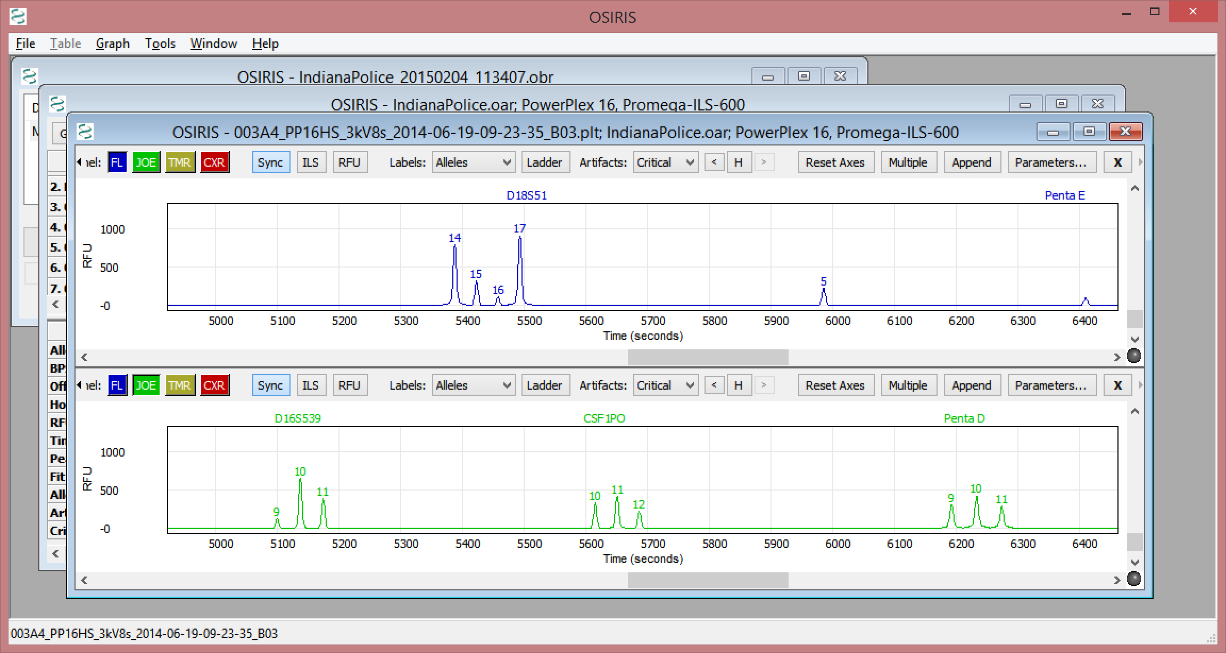
Old & New mixture models
Then: One binary dimension – Allele size list
15 17 18 28 29 30 31.2 14 15 16 17
D3S1358
D21S11
D18S511
Now: Two dimensions
→ Allele sizes
↑ Peak heights – continuous

Slide 8
Stochastic variation model
1000 rfu expected
1122 rfu
observed
Notes:
Before looking at LR relevant to DNA mixtures, let’s take a look at how a continuous model program might regard peak height and dropout.

Slide 9
Mixture likelihood without unknowns
Example hypothesis:
Mixture is G+C, proportion 5:4
Stochastic variation
Notes:
Colored rectangles = expected signal from each allele
Green loop = observed (epg) signal
Discrepancy = Stochastic variation

Slide 10
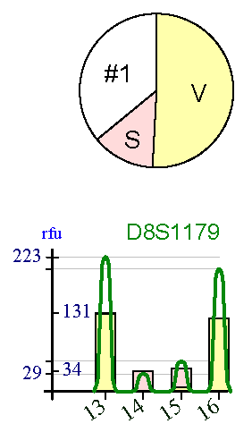
Mixture likelihood with unknowns

Slide 11
Coherent dropout model
Definitions –
  Analytical threshold (e.g. 35 rfu) means
    Level below which data not collected.
  Dropout (at an allele position) means
    No signal above analytic threshold
Consequence
  Dropout defined in terms of the stochastic model:
  Pr(dropout) = Pr(Stochastic variation from expected rfu to below Analytic Threshold)
Missing allele

Slide 12
Mixture Solution
Evidential value (likelihood ratio) for DNA mixtures
Unified model – minimum “moving parts”
  dropout, drop-in, peak height & stutter ratios – consequences of a single phenomenon.
Elegant model → Simplicity → …
  Robustness, speed, predictability, … and insight.
  Simpler than semi-continuous approach
  Mathematics instead of MCMC
stutter
Notes:
Einstein on simplicity
Robustness – Results are not particularly sensitive to small changes in assumptions/parameters.
Speed – Allows exploration.
Predictability --
Insight – the 1-person mixture. Differing #s of contributors. MCMC not needed even computing all genotypes for unknowns.

Slide 13
# of contributors
“Expert” advice: Start by determining the number of contributors!
Why is this a problem?
  How can we know the number?
  What’s a “contributor” anyway?
Notes:
“Expert” advice: Start by determining the number of contributors!

Slide 14
Rethinking “contributor”
What is a contributor?
  One DNA molecule donated? Amplified?
  Source of one florescence photon?
  Not operationally useful
  Source of “significant” florescence?
  Not well-defined
Conclusion: “# of contributors” isn’t a clear concept,
  therefore nonsense to insist it be same for Hp & for Hd.
    (Besides – who would get to decide?)
Program must determine best Prosecution & Defense choices separately by trying all #’s.

Slide 15
Stochastic threshold?
“never” happens
100 rfu
analytic threshold
Unobserved region
Artifice for analysis of simple stains.
Never made sense for mixtures.
Useful alternative: 1-person mixture analysis
+
=
donor A donor B A+B
Notes:
Simple stain: Trick to avoid mis-interpreting a heterozygote with dropout as a homozygote.
Mixture: Never made sense. E.g. SWGDAM et al 3-tiered mixture game solves nothing vis-à-vis the original bad boy
Solution? Instead of stochastic threshold for simple stain, 1-person mixture analysis

Slide 16
Insights
“Excluded” – meaningless or shifty term
“Contributor” not well-defined.
  “≥1 rfu”? – useless
  “Significant flourescence”? – vague
  Prosecution/Defense #s of contributors needn’t jibe
“Stochastic threshold” isn’t mixture-worthy
The 1-person mixture

Slide 17
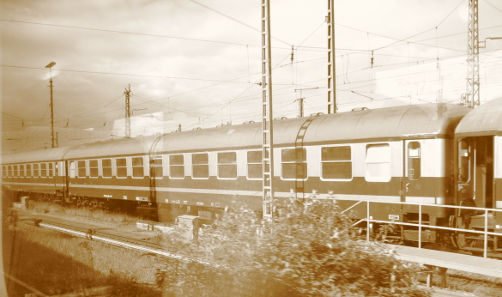
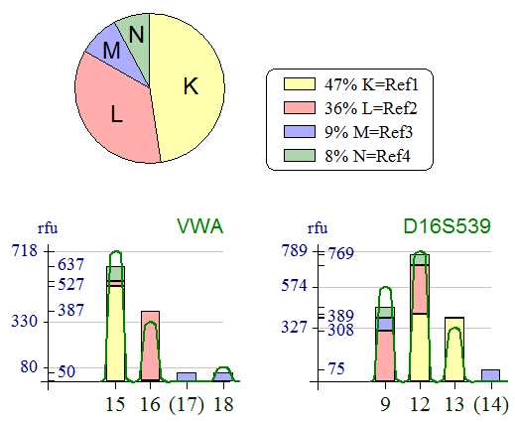
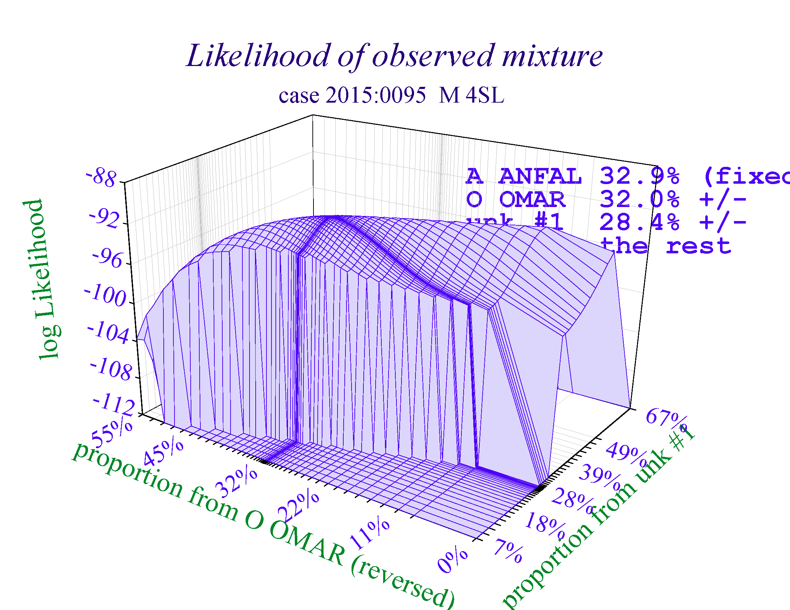
Mixture Solution
Demo: Bode booth – 1pm & 3pm Thu
Release in March
c@dna-view.com
+1 510 798 7139

